Slide 1
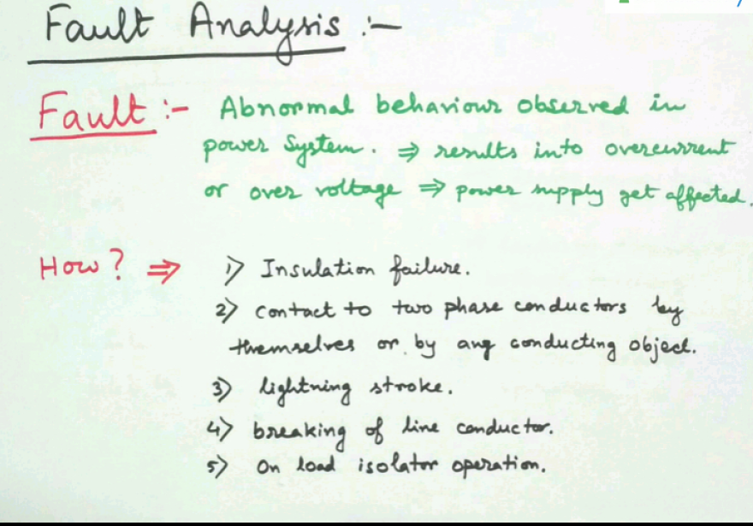
5

Slide 2
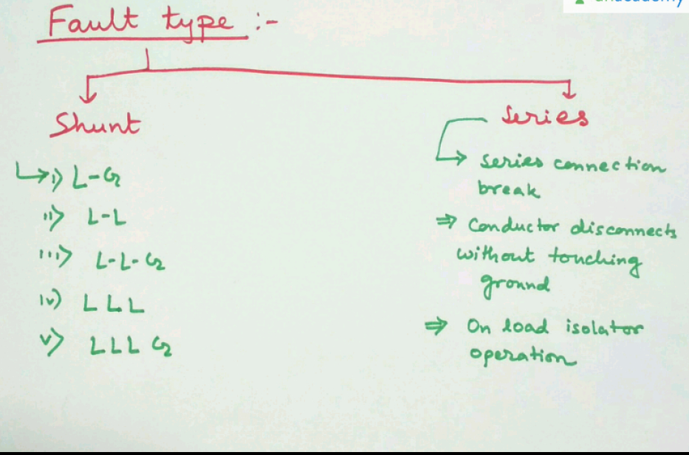

Slide 3
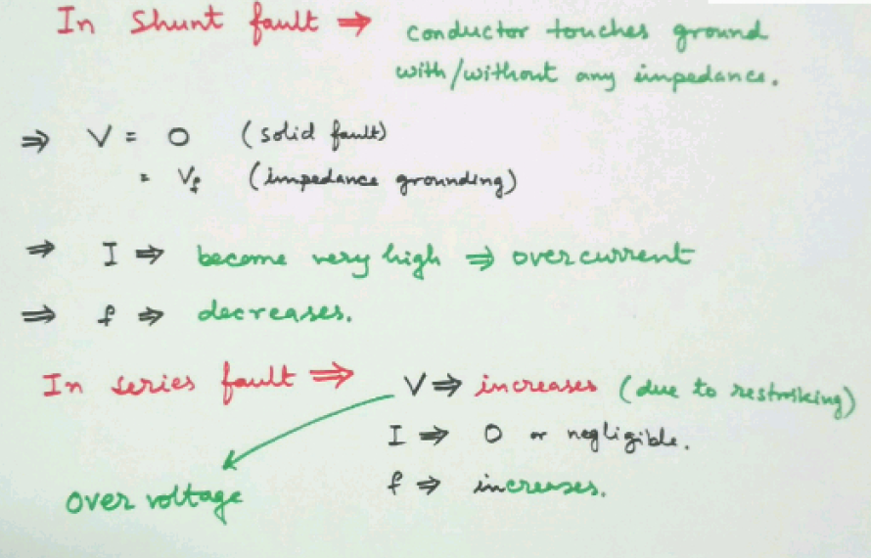

Slide 4
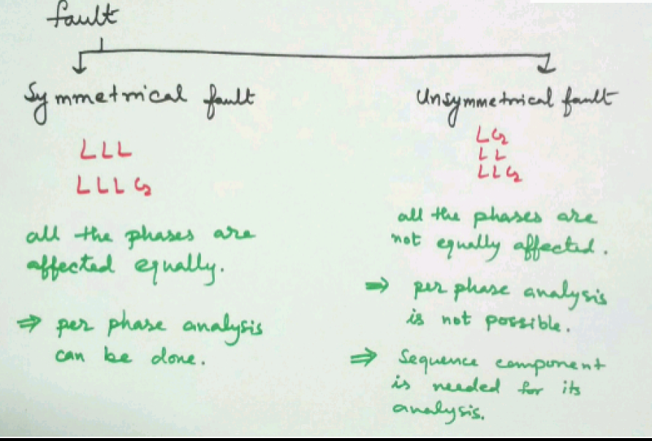

Slide 5
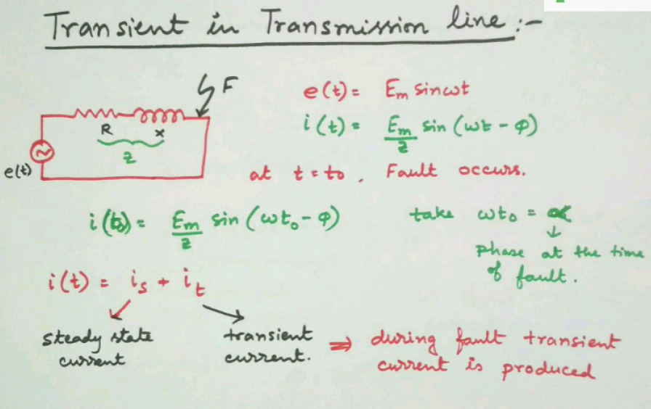

Slide 6
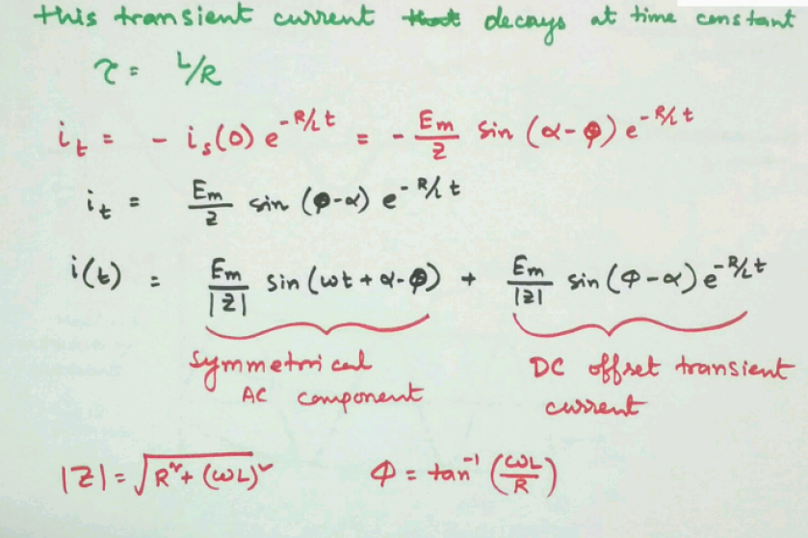

Slide 7
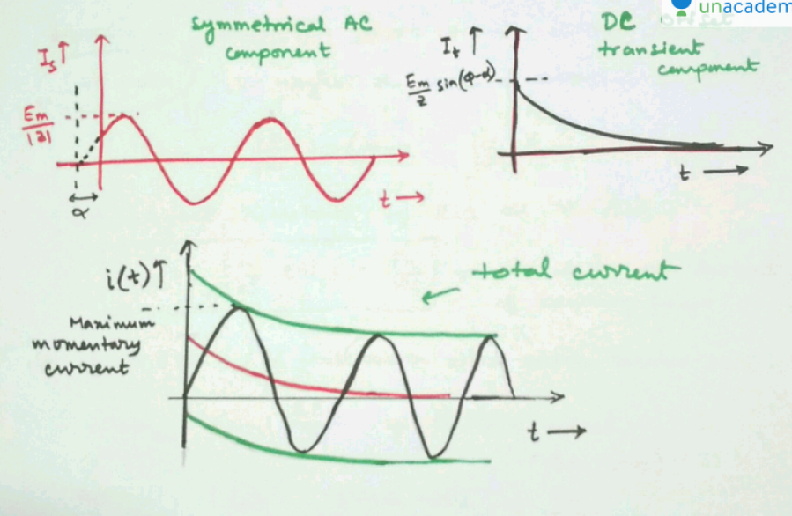
Off set

Slide 8
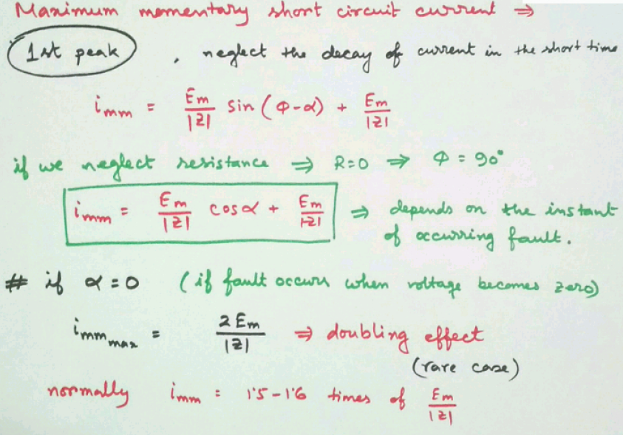

Slide 9
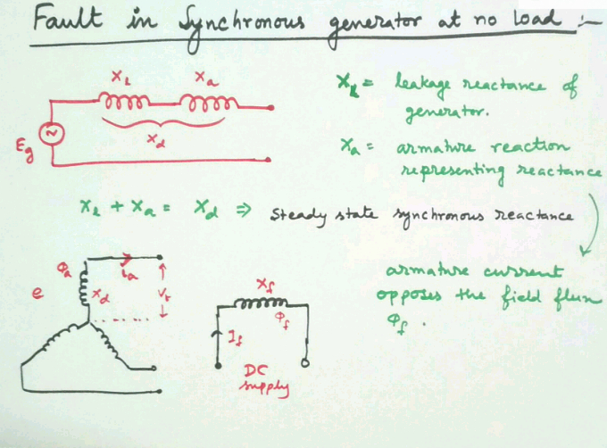

Slide 10
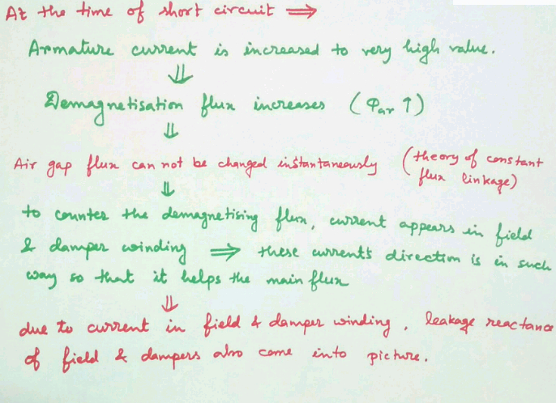

Slide 11
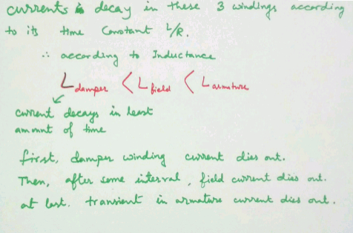

Slide 12
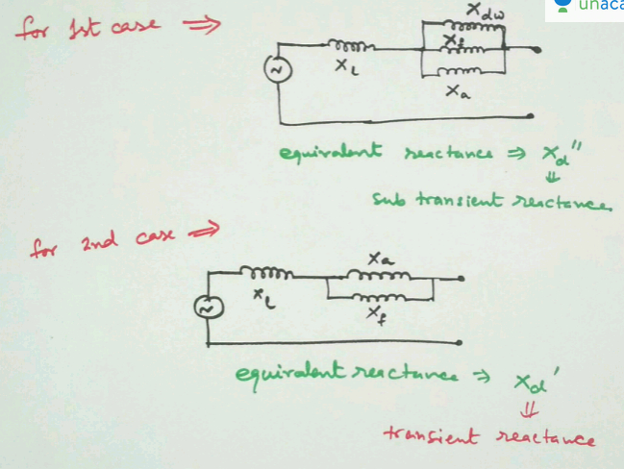

Slide 13
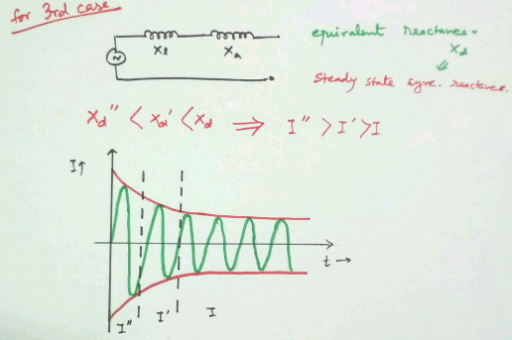

Slide 14
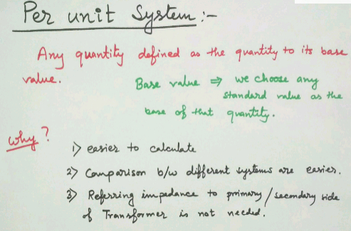

Slide 15
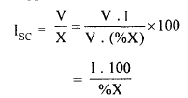
Percentage Values: The reactance of generators, transformers and reactors are generally expressed in percentage values to permit quick short circuit calculation.
Percentage reactance is defined as
%X=[IX/V]*100
where, I = full load current
V = phase voltage
X = reactance in ohms per phase
Short circuit current Isc in a circuit then can be expressed as,

Slide 16
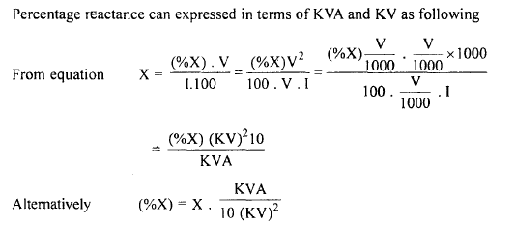

Slide 17
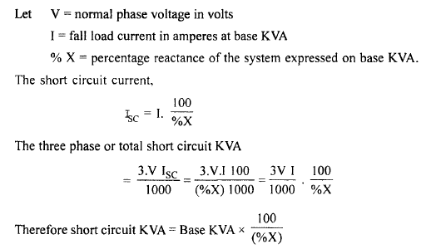

Slide 18
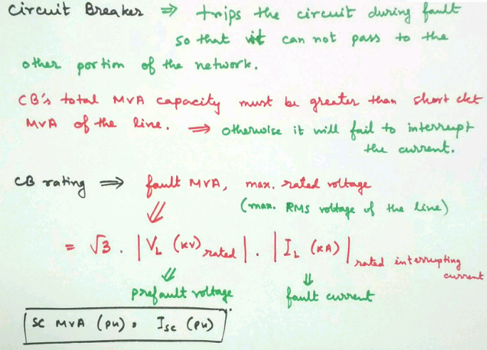

Slide 19
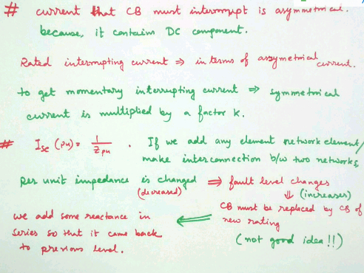

Slide 20
Reactors :Whenever faults occur in power system large currents flow. Especially, if the fault is a dead short circuit at the terminals or bus bars enormous currents flow damaging the equipment and its components.
To limit the flow of large currents under there circumstances current limiting reactors are used.
These reactors are large coils covered for high self-inductance.
They are also so located that the effect of the fault does not affect other parts of the system and is thus localized.
From time to time new generating units are added to an existing system to augment the capacity.
When this happens, the fault current level increases and it may become necessary to change the switch gear.
With proper use of reactors addition of generating units does not necessitate changes in existing switch gear.

Slide 21
Classification of Reactors
Generator reactors
Feeder reactors
Bus-bar reactors
The above classification is based on the location of the reactors. Reactors may be connected in series with the generator in series with each feeder or to the bus bars.

Slide 22
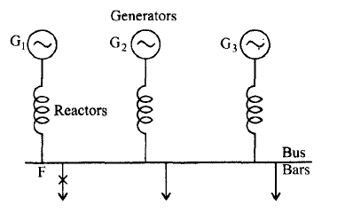
(i) Generator reactors
The reactors are located in series with each of the generators as shown in Fig. so that current flowing into a fault F from the generator is limited.
Disadvantages
(a) In the event of a fault occuring on a feeder, the voltage at the remaining
healthy feeders also may loose synchronism requiring resynchronization later.
(b) There is a constant voltage drop in the reactors and also power loss, even
during normal operation. Since modern generators are designed to with stand
dead short circuit at their terminals, generator reactors are now-a-days not
used except for old units in operation.

Slide 23
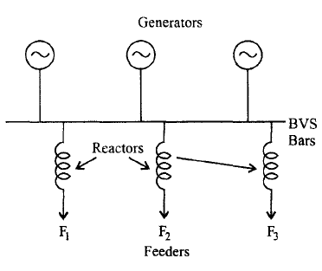
(ii) Feeder reactors:
In this method of protection each feeder is equipped with a series reactor as shown in Fig. In the event of a fault on any feeder the fault current drawn is restricted by the reactor.
Disadvantages:
I. Voltage drop and power loss still occurs in the reactor for a feeder fault. However, the voltage drop occurs only in that particular feeder reactor.
2. Feeder reactors do not offer any protection for bus bar faults. Neverthless,
bus-bar faults occur very rarely.
As series reactors inhererbly create voltage drop, system voltage regulation will be impaired. Hence they are to be used only in special case such as for short feeders of large cross-section.

Slide 24
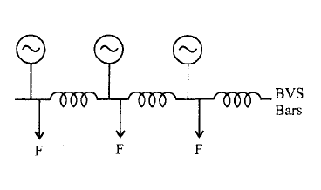
Bus bar reactors: In both the above methods, the reactors carry full load current under normal operation. The consequent disadvantage of constant voltage drops and power loss can be avoided by dividing the bus bars into sections and inter connect the sections through protective reactors. There are two ways of doing this.
(a) Ring system :
In this method each feeder is fed by one generator. Very little power flows across the reactors during normal operation.
Hence, the voltage drop and power loss are negligible.
If a fault occurs on any feeder, only the generator to which the feeder is connected will feed the fault and other generators are required to feed the fault through the reactor.

Slide 25
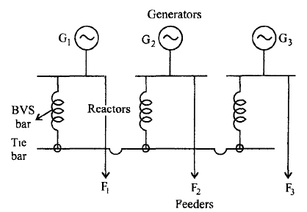
(b) Tie-bar system: This is an improvement over the ring system. This is shown in Fig. Current fed into a fault has to pass through two reactors in series between sections.
Another advantage is that additional generation may be connected to the system without requiring changes in the existing reactors.
The only disadvantage is that this systems requires an additional bus-bar system, the tie-bar.

